Slide 1
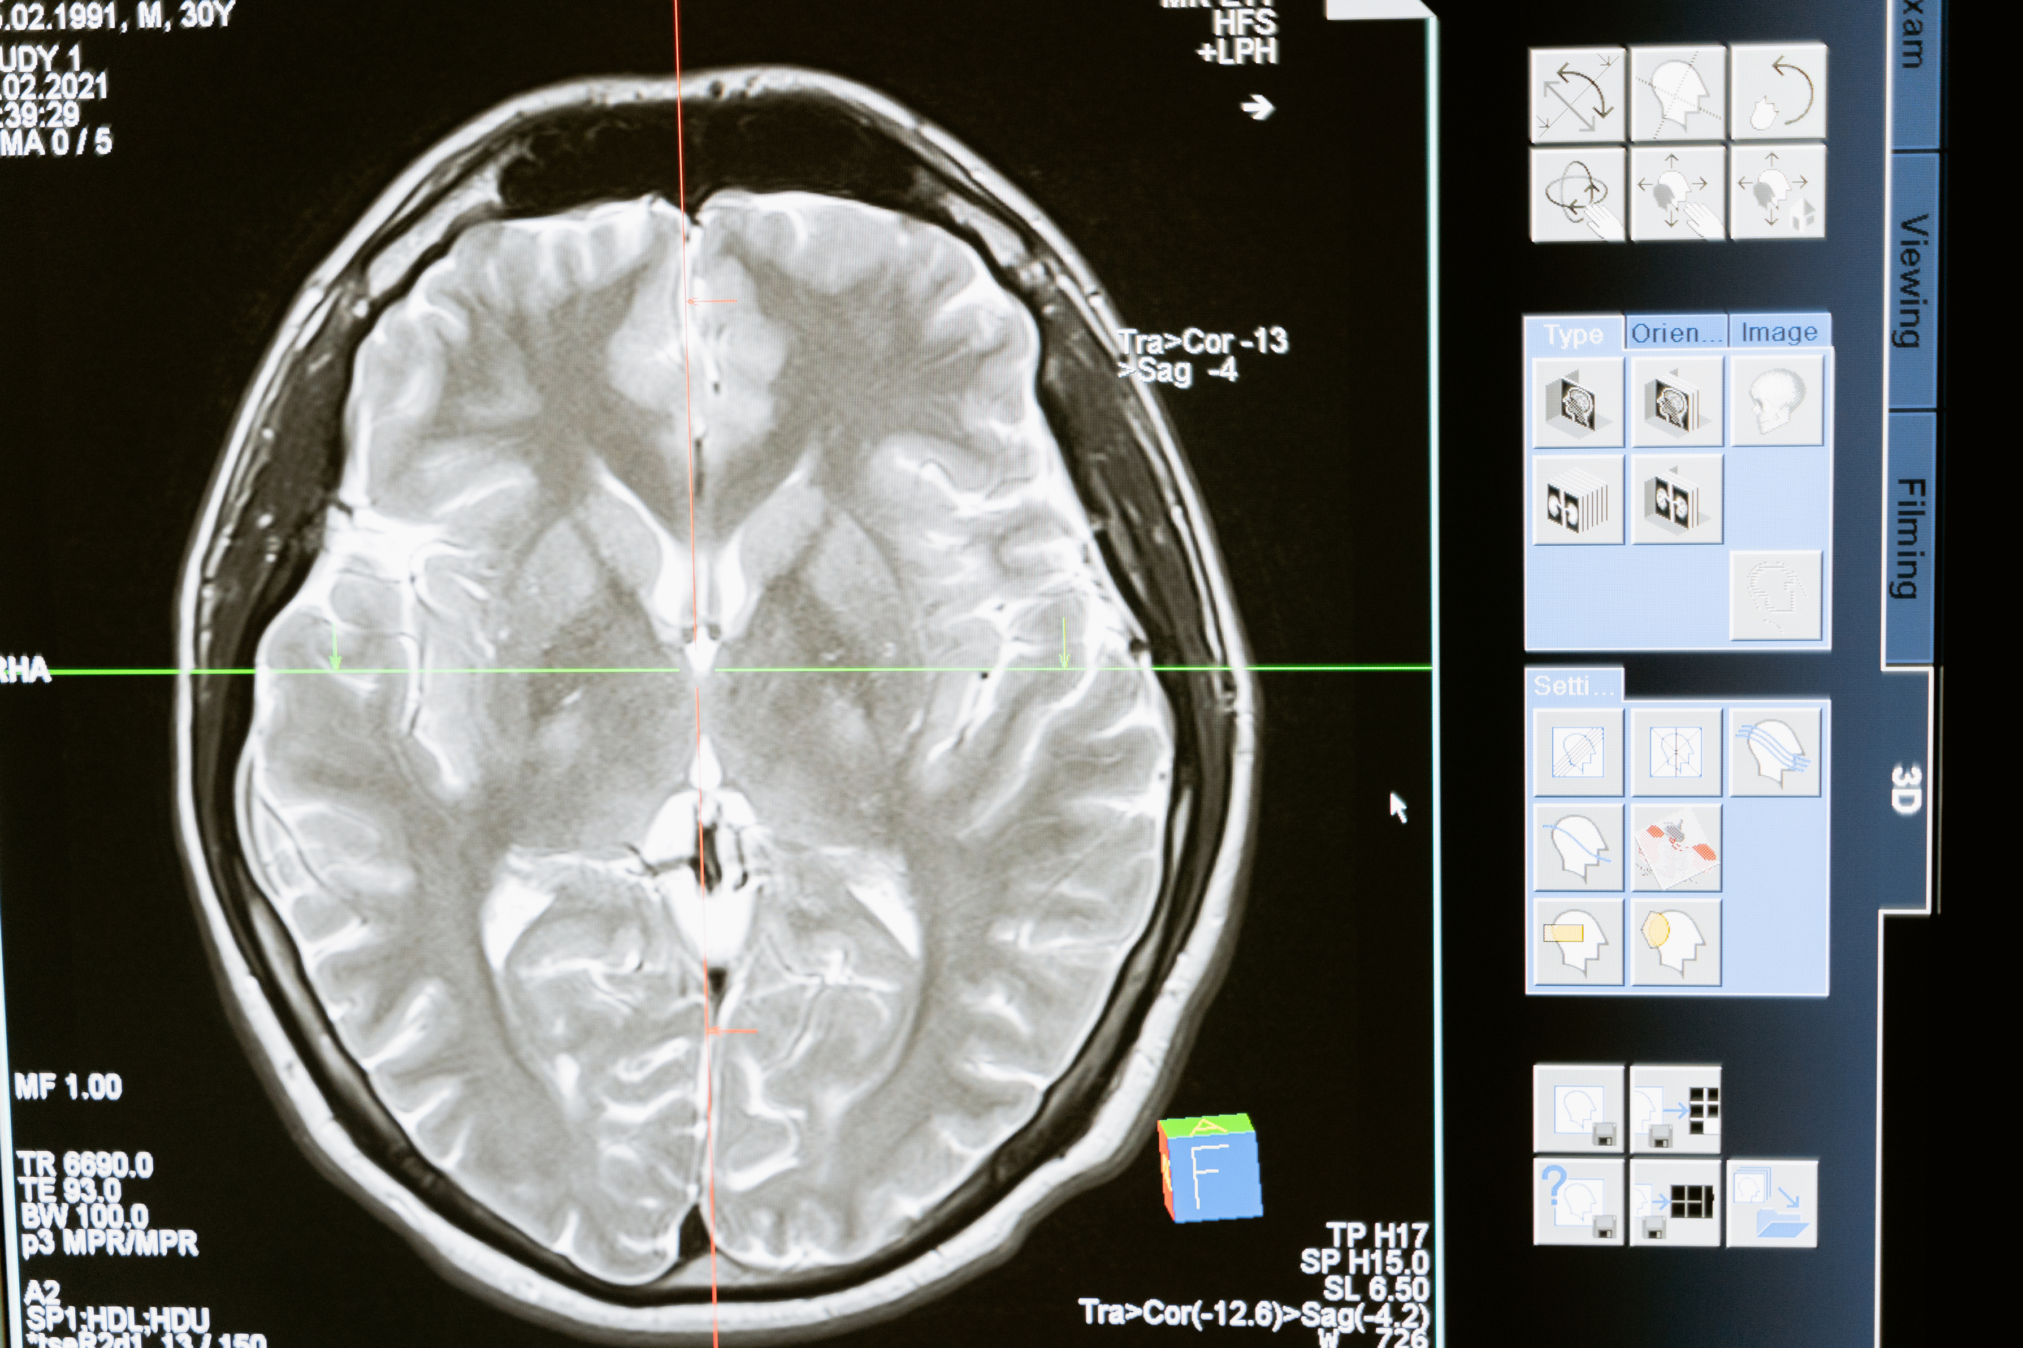

CONNExIN Bootcamp’25, Structural Team
How Do Participants Cortical/Subcortical Volumes Change Over time In Prevent-AD dataset ?
TEAM MEMBERS
ETHEL PHIRI, BIJAY ADHIKARI , ZAINAB MAGAJI MUSA, OLUWAPELUMI SOLAGBADE, BICKERSTETH OLUWATONI, ERNEST ZULU, PATRICK BONSU, METADEL HAILU
SUPERVISORS: ABDALLA MOHAMED, TOLULOPE OLUSUYI, SERGIO SOLIS BARQUERO

Slide 2

Motivation
Spotting brain changes early is very important for understanding how Alzheimer’s disease (AD) develops and for finding people who may be at higher risk, especially those with a family history.
The Prevent-AD dataset is a valuable resource that follows participants over time with brain scans. This makes it possible for researchers to track small changes in brain structure in people who do not yet show symptoms but are at risk.
Studying these changes across different sessions helps researchers learn more about the early stages of AD and test imaging markers that might predict future memory and thinking problems.
CONNExIN Bootcamp’25, Structural Team

Slide 3
DATA ACQUISTION AND ORGANIZATION
Dataset: Prevent-AD (Prevention of Alzheimer’s Disease)
MRI Acquisition: 3D T1-weighted anatomical scans, 1 × 1 × 1 mm³ isotropic resolution
Participants: 1
Sessions: 3 timepoints (Baseline Intermediate and 12-month follow-up]
Data Organization: Structured in BIDS format
Quality Control: Verified BIDS compliance, Automated QC using MRIQC v24.0.2
Data Organization: Curated in BIDS format,
CONNExIN Bootcamp’25, Structural Team

Slide 4
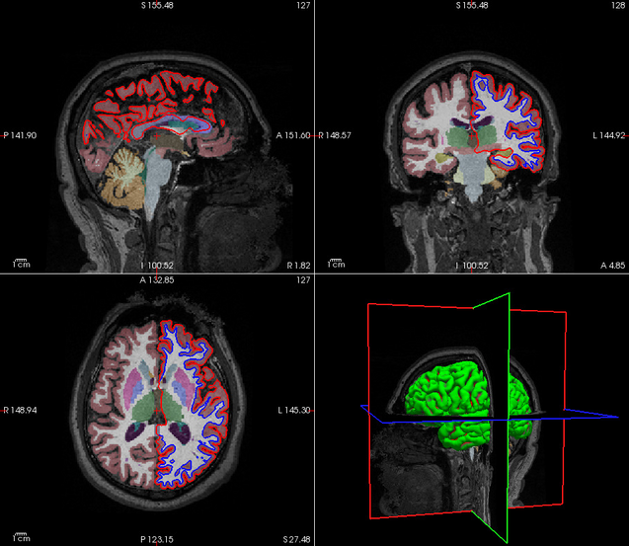
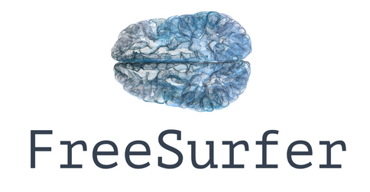
Pre-processing
Cross-sectional
Processing
Base Template
Generation
Longitudinal
Processing
Freeview visualization: raw T1w, skull-stripped, segmentation, cortical surfaces
volume/thickness extraction
CONNExIN Bootcamp’25, Structural Team

Slide 5
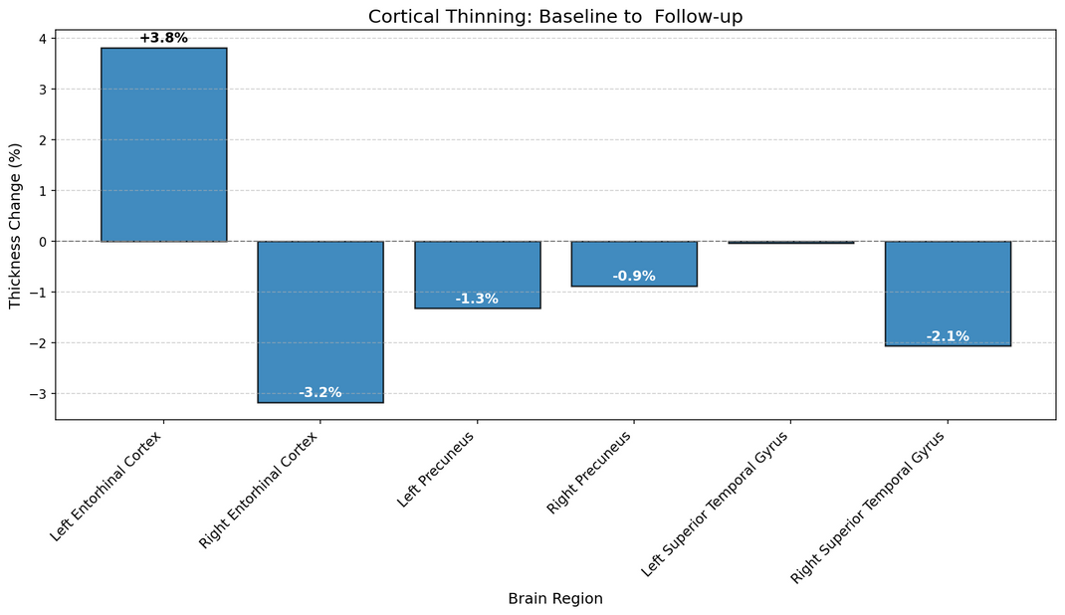
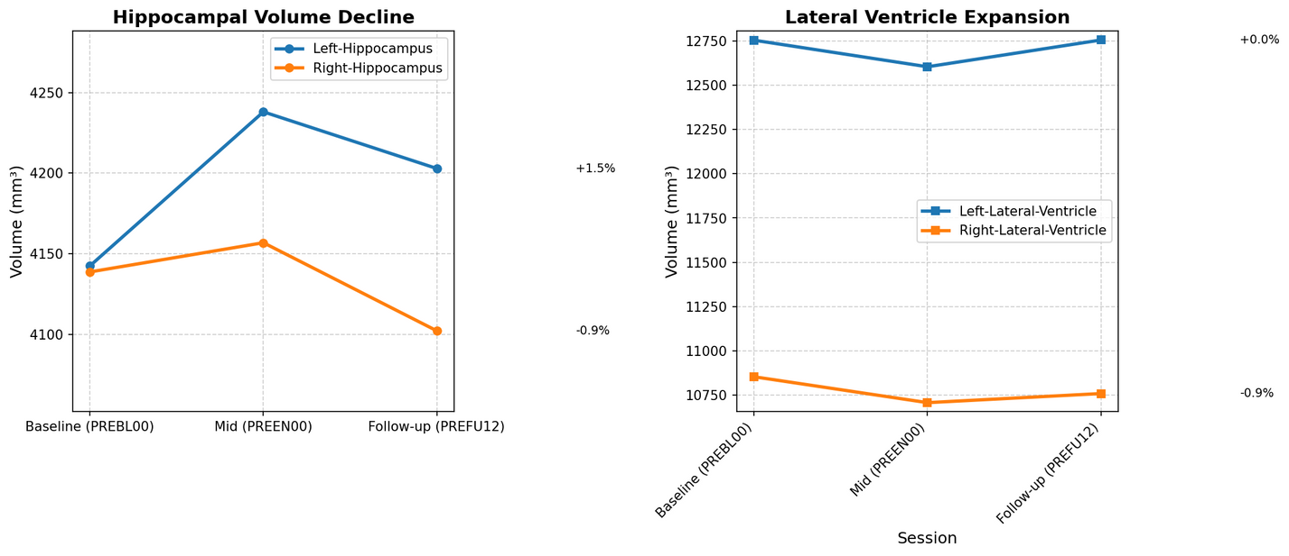
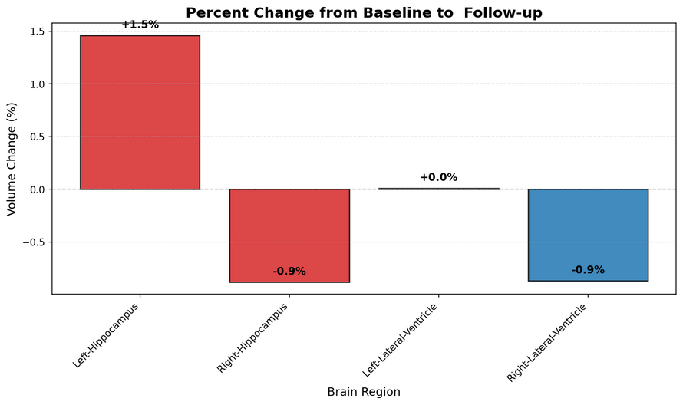
Analysis
CONNExIN Bootcamp’25, Structural Team

Slide 6
Lessons learned
Learned that even small errors (like a misplaced comma) can prevent the dataset from validating.
Learned to embrace errors when working on a project.
Learned to meticulously check all file paths and data structures.
Learned that data validation is not a one-time task.
Reliable infrastructure and HPC access are as vital as methodology;
CONNExIN Bootcamp’25, Structural Team

Slide 7
NEXT STEPS..
CONNExIN Bootcamp’25, Structural Team

Slide 8
Q & A
CONNExIN Bootcamp’25, Structural Team

